Slide 1

Logit Regressions
(For Discrete Dependent Variable)

Slide 2
MKT 591: Course Roadmap
Review of Quant Market Research
Prediction / Regression
Forecasting
Features & Dimensions
Market Segmentation
Simple Linear Regression
Demand Forecasting
Customer Classification
Factor Analysis
Segmentation Basic
Measurement Scales
Categorical Variables
BASS Diffusion Model
Discriminant Analysis
MDS
Advanced Model-based Segmentation
Discrete Analysis (CrossTab)
Extracting Features by Text Analytics
Multiple Regression
Bayesian Classifier
Spatial Segmentation
Continuous Analysis (Correlation)
Issues in Regression
Tree Models
Intro Deep Learning
Logistic Regression (Consumer Choice)
Intro Bayesian Statistics

Slide 3
Other Regressions
So far, Least Square Regression (aka OLS): When dependent variable is continuous and assumed to be normally distributed.
What if DV is:
Nominal (e.g., Buy Yes or No, Choice Brand A, B or C, etc.)
For binary – Binary Logistic regression or probit regression
For multinomial – Multinomial Logistic or multinomial probit regression
Ordinal (e.g., Star Ratings) – Ordinal Regression
Count information (e.g., how many consumers visit?) – Poisson regression, negative binomial regression

Slide 4
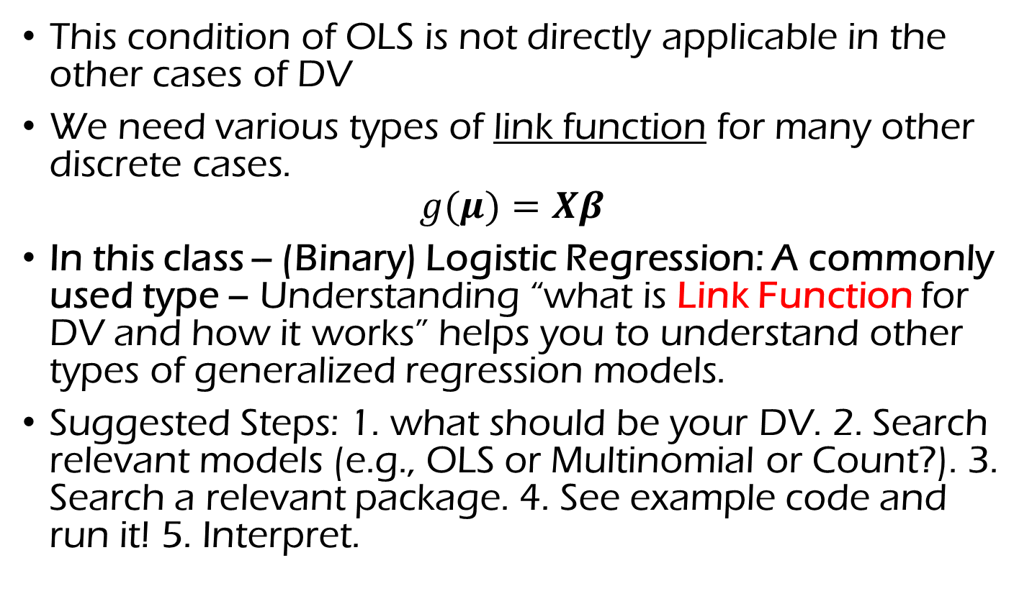
Generalized Linear Models
This condition of OLS is not directly applicable in the other cases of DV
We need various types of link function for many other discrete cases.
$$g(μ)=Xβ$$
In this class -- (Binary) Logistic Regression: A commonly used type – Understanding “what is Link Function for DV and how it works” helps you to understand other types of generalized regression models.
Suggested Steps: 1. what should be your DV. 2. Search relevant models (e.g., OLS or Multinomial or Count?). 3. Search a relevant package. 4. See example code and run it! 5. Interpret.

Slide 5
Agenda for Today
Marketing Application Example
Binary Logistic Regression Model
Cross-Validation concept and application for predictive choice performance

Slide 6

Examples and Motivation
Various Choice/Discrete Situations are common in Marketing
Choice Examples in Marketing (These choices are discrete scales!)
Catalog purchase (Buy / No Buy)
Click or not in Online Search Advertising
Pair-wise choice data : Select between brand A and brand B
It is important to correctly interpret the effects of IVs on DV (Beyond significance of the model or Independent Variables).
It is important to understand how to build managerial implications to solve business/marketing problems.

Slide 7
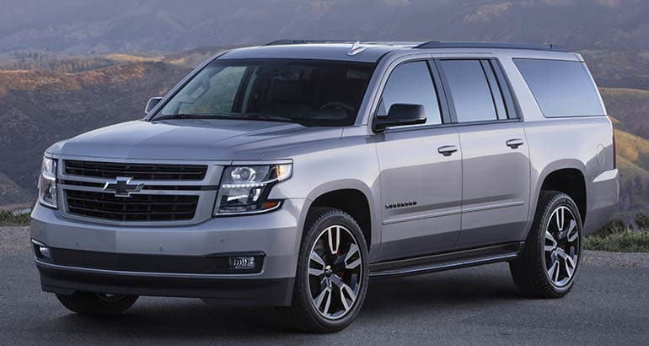
Large SUV Choice Application Research (Kim, DeSarbo and Fong 2018, JMP)
A tracking study to gauge automotive marketing choice consideration behavior by a Large US automotive consumer research supplier.
Sample Size: 290 consumer intenders for large sport utility.
DV: Intention to buy YES or NO for16 SUV brands and they used a five-point interval scale to rate each vehicle on 24 attributes.

Slide 8
Visualization
DV: Multiple Choices (Yes or No)
DV:
...
Feature 1
Regression Setting is Different?
What is a difference?
DV:
Choice 2
DV:
Choice SUV 1
Segment 1
Feature 5
IV: Feature 1
Correlation Matrix 1
IV: Feature 2
IV: Feature 3
Feature 2
This paper conducted probit regression in Bayesian setting (R code is available in my Website)
Segment 2
Feature 5
Correlation Matrix 2
IV: Feature P
Notes:
Let’s revisit to Bernie’s problem!

Slide 9
Attributes (Independent Variables) | Large SUV Brands
foreign (Foreign Brands), gasmile (Excellent Gas Mileage), value4money (Good Value for the Money), workmanship (Excellent Workmanship), ride-handling (Good Ride/Handling – Streets & Highways), load-unload (Easy to Load & Unload), lurxurious (Luxurious), safety (Good Safety/Protection for Occupants), ride-offroad (Good Ride & Handling Off-Road), rugged (Built Rugged and Tough), towing (Excellent Towing Capability), price (Reasonably Priced), sporty (Sporty), good-looking (Good Looking), family-use (Good Vehicle for Family Use), fun2drive (Fun to Drive), passenger room (Good Interior Passenger Room), enter-exit (Easy to Enter/Exit), dependable (Dependable), acceleration (Excellent Acceleration), cargo space (Excellent Cargo Space), prestigious (Prestigious), tech-adv (Technically Advanced), trade-in (High Trade-in Value). | Chevy Suburban, Chevy Tahoe, Ford Expedition, Range Rover, Toyota Land Cruiser, Yukon Denali, Ford Excursion, Lincoln Navigator, Lexus LX470, Toyota Sequoia, Hummer H1, Escalade EXT, GMC Yukon, Mercedes G Class, Hummer H2, Escalade ESV.

Slide 10
The Proposed Models: Model Selection
 | K=1 | K=2 | K=3 | K=4 | K=5
DIC | 2480.1 | 2291.7 | 2299.8 | 2339.2 | 2408.5
BIC | 2522.8 | 2429.7 | 2473.1 | 2500.7 | 2682.4
K=2 has been selected (Note: Select Lower values in DIC and BIC).
Notes:
First of all, the higher value in model selection heuristics means better solution. For Unconstrained model, 2 Segment is the best solution. For common Factors, … However, overall 2 segment solution of the Distinctive factors model is the best solution.

Slide 11
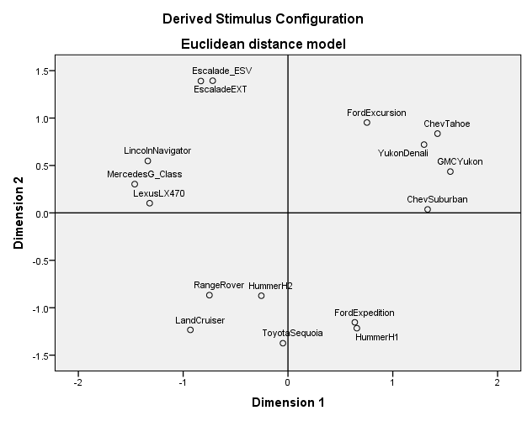
MDS Mapping based the estimated correlation matrix
Foreign Brands
GM Brands

Slide 12
Choice Predictive Validation Performance Comparison between the Proposed Model and Other Benchmark Models
Measures | Two Holdout Brands | Aggregate Logistic Regression | Aggregate Stepwise Logistic Regression | Bayesian Multivariate Probit Regression | Multivarite Probit Mixture model (without Variable Selection) | The Proposed Model
Choice Hit Rate | GMC Yukon Choice Prediction | 57% | 57% | 56% | 57% | 64%*
 | Ford Expedition Choice Prediction | 66% | 66% | 66% | 66% | 70%*
Jaccard Similarity Index | GMC Yukon Choice Prediction | 36% | 35% | 35% | 36% | 50%*
 | Ford Expedition Choice Prediction | 31% | 31% | 32% | 34% | 43%*

Slide 13
Binary logistic regression
The outcome variable is binary (in this class)
Can be coded:
Y = 1 (if “Yes”)
Y = 0 (if “No”)
Dependent Variable: Discrete (Nominal Variable)
There is likely to be a set of X variables (possibly marketing interventions or consumers’ characteristics) that we want to use to predict or explain when the response is “yes” versus the response is “no”.

Slide 14

Example 1 – Catalog Shopping Case Data
Assuming purchase decision scenario in a catalog shopping.
Independent Variables (Predictors)
Recency – how many months since last purchase of consumers
Frequency – how many times customer has purchased last year
Monetary – Total $ amount customer has purchased last year
** to identify target market for developing different marketing strategies.
Dependent Variable
Buy / No Buy

Slide 15
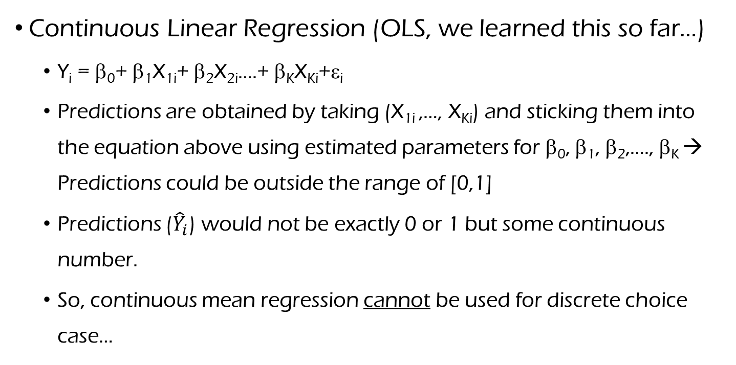
Why not Continuous Regressions for discrete DV? Let’s try OLS first!
Continuous Linear Regression (OLS, we learned this so far…)
Y_{i} = β₀+ β₁X_{1i}+ β₂X_{2i}….+ β_{K}X_{Ki}+ε_{i}
Predictions are obtained by taking (X_{1i} ,…, X_{Ki}) and sticking them into the equation above using estimated parameters for β₀, β₁, β₂,…., β_{K} → Predictions could be outside the range of [0,1]
Predictions (${\hat{Y}}_{i}$) would not be exactly 0 or 1 but some continuous number.
So, continuous mean regression cannot be used for discrete choice case…

Slide 16
Choice Predictions with Linear Regression
(Continuous) Linear Regression Line
1
Observed Choices
(e.g., 1 or 0)
0
Is this the OLS line the best explanation for the observed choices? Nothing is impossible but it is weird…
Notes:
Pred(Choice) refers the predicted value by using the RHS of OLS.

Slide 17
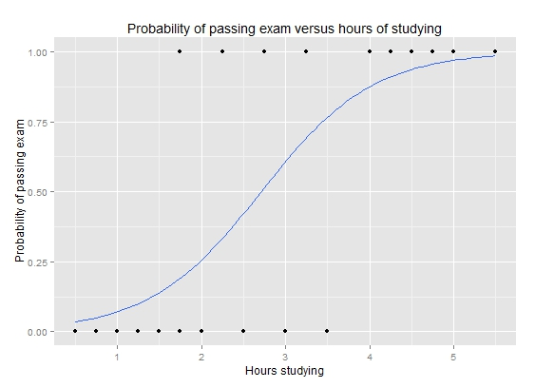
Logistic Regression Probability Pattern Example
(One part of the DV Estimation Procedure)
(X: Predictor)

Slide 18
The (Binary) Logistic Regression Model
The basic idea behind logistic regression is that you have an observed discrete outcome Y_{i}, with associated predictor variables X_{1i},…, X_{Ki}.
The model states that:
Y_{i} = 1 (Yes Buy) with probability p_{i}
Y_{i} = 0 (No Buy) with probability 1 - p_{i}
We need a link function between Yi and β₀+ β₁X_{1i}+ ….+ β_{K}X_{Ki}

Slide 19
The (Binary) Logistic Regression Model
The basic idea behind logistic regression is that you have an observed discrete outcome Y_{i}, with associated predictor variables X_{1i},…, X_{Ki}.
The model states that:
Y_{i} = 1 (Yes Buy) with probability p_{i}
Y_{i} = 0 (No Buy) with probability 1 - p_{i}
logit(p_{i}) = ln(p_{i}/(1-p_{i})) = ln(odds) = β₀+ β₁X_{1i}+ ….+ β_{K}X_{Ki}
Now, ln(odds) can be continuous value!
I will explain the logit link more details soon…

Slide 20
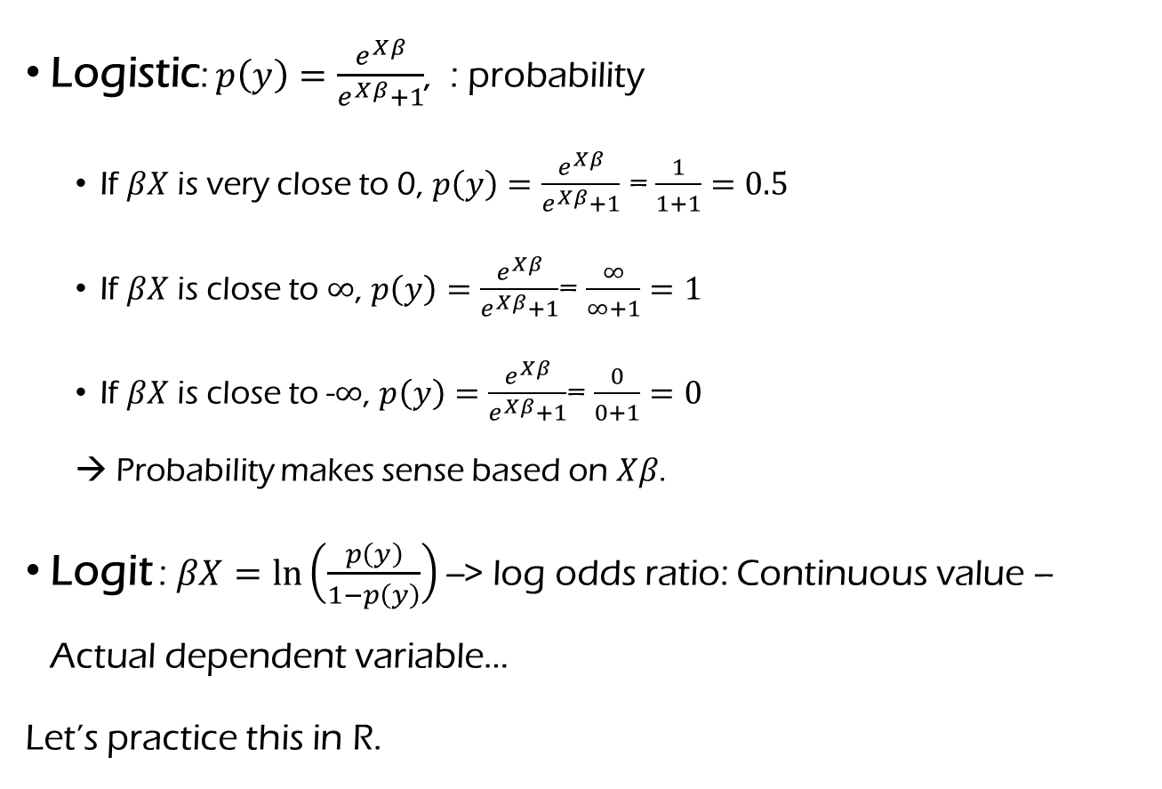
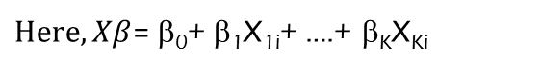
Basic Concepts of Logistic / Logit
Logistic: $p\left(y\right)=\frac{e^{Xβ}}{e^{Xβ}+1}$, : probability
If $βX$ is very close to 0, $p\left(y\right)=\frac{e^{Xβ}}{{}^{}e}Xβ$ = $\frac{1}{1+1}=0.5$
If $βX$ is close to $∞$, $p\left(y\right)=\frac{e^{Xβ}}{e^{Xβ}+1}$= $\frac{∞}{∞+1}=1$
If $βX$ is close to -$∞$, $p\left(y\right)=\frac{e^{Xβ}}{e^{Xβ}+1}$= $\frac{0}{0+1}=0$
→ Probability makes sense based on $Xβ$.
Logit : $βX=ln⁡\left(\frac{p\left(y\right)}{1−p\left(y\right)}\right)$ --> log odds ratio: Continuous value – Actual dependent variable…
Let’s practice this in R.
$Here, Xβ$= β₀+ β₁X_{1i}+ ….+ β_{K}X_{Ki}
Notes:
Sigmoid function in Machine Learning. Sigmoid function is bound between 0 and 1 and has S shape… Convergence between 0 and 1 is very slow, unless we are using sigmoid function.
cdf of standard logistic distribution

Slide 21
More about the model
If you model:
p_{i}= β₀+ β₁X_{1i}+ β₂X_{2i}….+ β_{K}X_{Ki}, (here, p_{i} is probability)
β₀+ β₁X_{1i}+ β₂X_{2i}….+ β_{K}X_{Ki} could get predicted probabilities outside of [0,1], but p_{i} must be between 0 and 1… You might need additional constraint but it is not so common.
The “logit” or log-odds link function guarantees that predictions will be between 0 and 1.

Slide 22
Interpretation of the coefficients
So, the logistic model says:
logit(p_{i}) = ln(p_{i}/(1-p_{i})) = ln(odds) = β₀+ β₁X_{1i}+ ….+ β_{K}X_{Ki}
So, how to interpret β_{k}?
It is NOT the change in Y for a given change in X_{k}.
It is NOT the change in p_{i} for a given change in X_{k}.
Instead, coefficients are related to the logarithm of odds ratio (this is called as ‘logit’).
Now, ln(odds) can be continuous value!
I will explain the logit link more details soon…

Slide 23
Interpretation of Coefficients
⇔
logit(p_{i}) = ln(p_{i}/(1-p_{i})) = ln(odds) = β₀+ β₁X_{1i}+ ….+ β_{K}X_{Ki}
Remember: Coefficients affect log(odds ratio), not dependent variable (e.g., Y) directly. – let’s see an example soon…

Slide 24
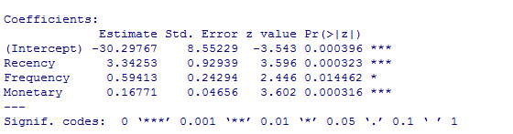
Logistic Regression Output
How to interpret the effect of Recency?
How to interpret the effect of Frequency?
Notes:
Deviance is a measure of goodness of fit of a generalized linear model. Or rather, it’s a measure of badness of fit–higher numbers indicate worse fit.
The null deviance shows how well the response variable is predicted by a model that includes only the intercept (grand mean).
For our example, we have a value of 43.9 on 31 degrees of freedom. Including the independent variables (weight and displacement) decreased the deviance to 21.4 points on 29 degrees of freedom, a significant reduction in deviance.

Slide 25
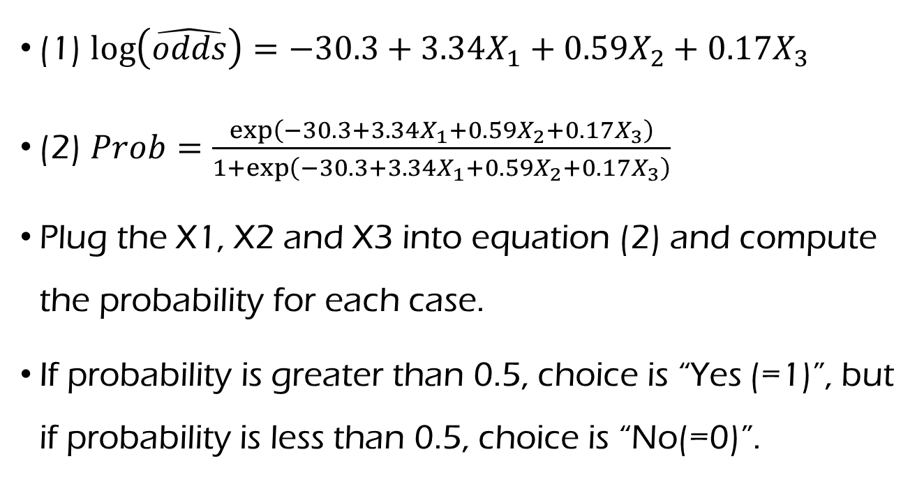
Logistic Regression Predictions
(1) $\log\left(\hat{odds}\right)=−30.3+3.34X_{1}+0.59X_{2}+0.17X_{3}$
(2) $Prob=\frac{\exp\left(−30.3+3.34X_{1}+0.59X_{2}+0.17X_{3}\right)}{1+\exp\left(−30.3+3.34X_{1}+0.59X_{2}+0.17X_{3}\right)}$
Plug the X1, X2 and X3 into equation (2) and compute the probability for each case.
If probability is greater than 0.5, choice is “Yes (=1)”, but if probability is less than 0.5, choice is “No(=0)”.
→ This is a approximation scheme to overcome limited information. Same in sigmoid function in machine-learning…

Slide 26




Logistic Regression Predictions
$$Hit$$
$$Error$$
$$Hit$$
$$Error$$

Slide 27
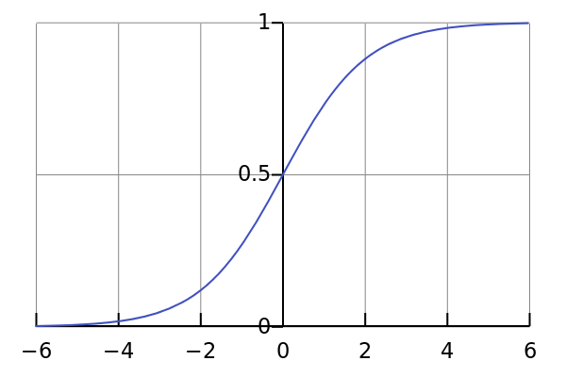
Graphically, Choice Prediction
Y=1
Y=0

Slide 28
Measure of fit (in-sample)
Observed value
Hit Rate (quasi-R²)
Classification table for the estimation sample (Variable Choice):
from \ to | 0 | 1 | Total | % correct
0 | 51 | 4 | 55 | 92.73%
1 | 2 | 43 | 45 | 95.56%
Total | 53 | 47 | 100 | 94.00%
Predicted value
How to interpret this classification table?
Do you think this (in-sample) fit performance is good?

Slide 29
External Sample Prediction Practice with R
What is the Log Odds value that a customer will buy with recency of 4, frequency of 9, and total monetary value of 66.71? What is probability?
What is the Log Odds value that a customer will buy with recency of 5, frequency of 8, and total monetary value of 70? What is likelihood for the customer?
Notes:
Let them practice this in Class…

Slide 30
Change in Predicted Probability (see R simulation example for this)
Notice a few things:
Non-linear function
Steepest in the middle
Asymptotes at 0 and 1

Slide 31
Marketing Application Example: Customer Acquisition by A Car Dealer
A car dealer is trying to understand the key drivers of who becomes their customer and who does not (Binary DV).
The dealer purchases 100 names and address of neighborhood habitants from ‘JD Powers’ Company, and targets them using Marketing mixes of:
Billboards
Emails
Mail Coupons

Slide 32


Customer Acquisition by A Car Dealer
The dealer measures whether they become their customer (Y=1) or did not (Y=0) after 6 months.
The company wants to understand which Marketing efforts of theirs were effective in driving customer acquisition.

Slide 33
Customer Acquisition Data Summary
Variables
Distance – Distance from the dealer in miles
Billboard AD – Expected number of times the household saw the billboard in an average month
Email – Which email was sent
0: None
1: Email promoting ‘service quality’
2: Email promoting ‘low prices’
Coupon – Dummy Variable (Sent / Not Sent)
Customer Acquired / Not (DV)

Slide 34
In-Class R Practice (10 minutes): Questions Use ‘JDPowers.csv’ data file in Blackboard.
1. Which marketing tools are having an significant impact of customer acquisition?
2. Which email worked best?
3. How to interpret the effect of coupon?
4. What is the likelihood (for acquiring the customer) that a customer located 2 miles from the dealership who has received a coupon but no email and who sees the billboard 30 times a month will become a customer?

Slide 35
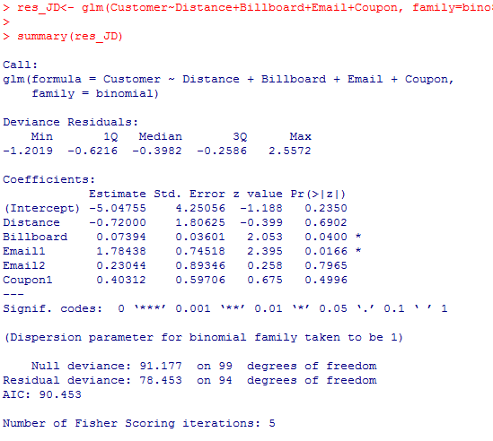
Logistic Regression outputs

Slide 36
In-Class R Practice Extension Question
If the cost of buying an email address list is $15 per customer and the Customer Life Time Value of an acquired customer is $1,000, is it worth:
Buying the email address list and sending emails (assuming 2 miles, 30 billboard and no coupon) is valuable?
Notes:
Second email has limited value

Slide 37
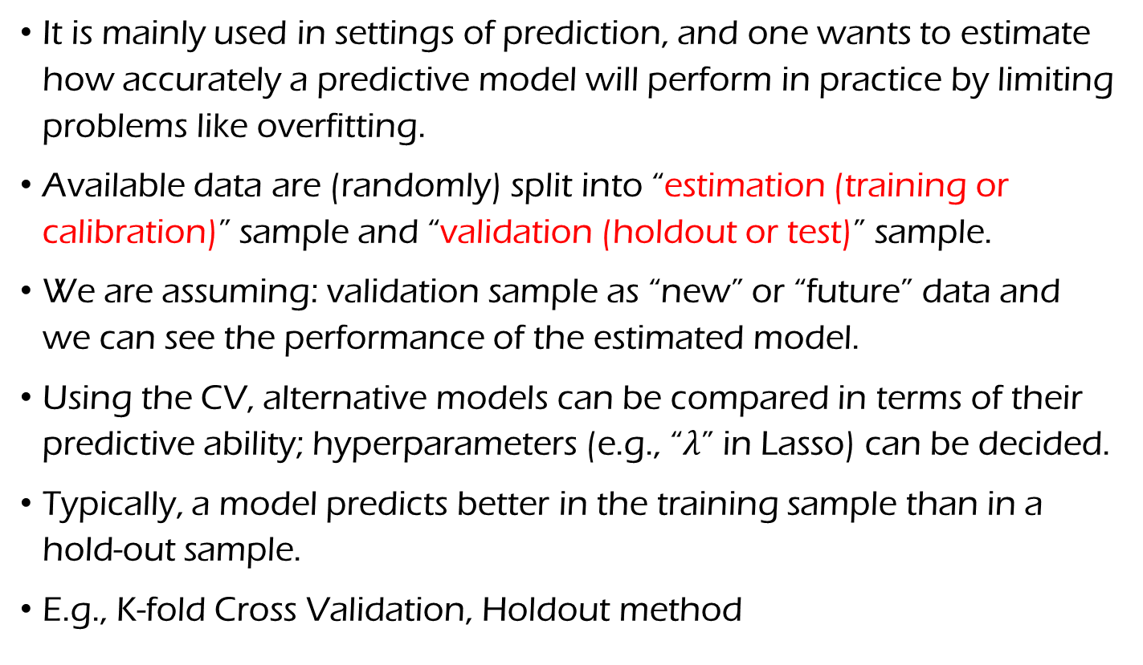
Cross Validation & Predictive Validity
It is mainly used in settings of prediction, and one wants to estimate how accurately a predictive model will perform in practice by limiting problems like overfitting.
Available data are (randomly) split into “estimation (training or calibration)” sample and “validation (holdout or test)” sample.
We are assuming: validation sample as “new” or “future” data and we can see the performance of the estimated model.
Using the CV, alternative models can be compared in terms of their predictive ability; hyperparameters (e.g., “$λ$” in Lasso) can be decided.
Typically, a model predicts better in the training sample than in a hold-out sample.
E.g., K-fold Cross Validation, Holdout method

Slide 38
Punch Line
Logistic Regression is a very widely used technique when your outcome variable is discrete scales
Classification
Prediction
For binary discrete DV (e.g.,1 for yes, 0 for no), continuous regressions (e.g., OLS) is not appropriate as you can get estimates outside the range of [0,1].

Slide 39

Bank Marketing Data (More et al. 2011)
Human agents execute telemarketing phone calls to sell long-term deposits.
The result is a binary unsuccessful or successful contact.
Data collected from a Portuguese retail banking institution, from May 2008 to June 2013 in total 41188 phone contacts.
Marketing Analytic Questions:
Who are the profitable customers segment (i.e., open long-term deposits)?
How to predict or classify the profitable customer segment?
What are the important variable (criteria) for classifying the profitable consumer segment?
See https://archive.ics.uci.edu/ml/datasets/bank+marketing for details

Slide 40
Bank Marketing Data In-Class Practice in R
I will show how to randomly split sample into two sets for cross-validations (let’s use set.seed(100)…)
First, run the binary logistic regression using age, marital, housing, and duration with training dataset.
Check the correct prediction hit with training dataset.
Second, let’s apply the trained model to valid dataset.
Check the correct prediction hit with valid dataset. How the result look like?

Slide 41
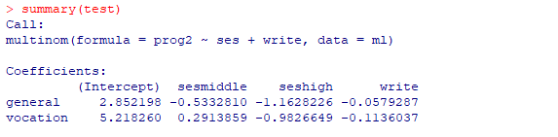
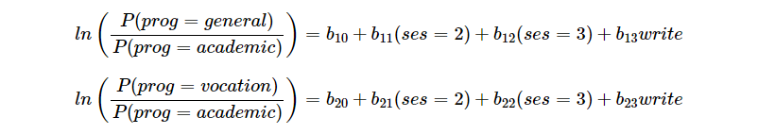
For Further study about Multinomial Case
https://stats.idre.ucla.edu/r/dae/multinomial-logistic-regression/
See the website for computing p-value for each predictors.

Slide 42
Concluding remarks for regression models
We don’t have to memorize all types of regression for now, but you should study, choose and apply a justifiable regression for your problem.
It’s important to justify why you choose your regression to your problem.
Statistically: Cross Validation (Prediction Ability), Model Selection Criteria (AIC or BIC)
Managerially: What is main interests for your business?
My opinion: given you cannot memorize all of models, it is important to have your own capability to study any new model.

Slide 43
Data Collection Methods in Marketing

Slide 44

Secondary Data.
We have various sources for secondary data:
Commercial Sources (E.g., AC Nielson: Scanner-based Sales Data; IRI household sales data); some MSBA students got jobs from these companies last year… ☺
Review sites – by Web scrapping technique
Government Sources (E.g., US Census of Population)
Books and Periodicals; Media Sources (E.g., CNN Financial News)
We can get those:
Libraries, Internet.
E.g., http://www.socialexplorer.com/

Slide 45
Secondary Data by Market Research Firm Example 1: Store Audit Data
IRI, A.C. Nielsen, Audits and Surveys: http://www.nielsen.com/us/en.html
Research firms send a team of auditors to a sample of store which represent major geographic areas.
Sales (volume and share) / Selling prices / Retailer support / Media Advertising
Grocery product / Drugs / Alcoholic beverages etc.
Notes:
Research firms send a team of auditors to a sample of store which represent major geographic areas all over the States every two months.
They collect information on the sales / selling prices / retailer support (shelf space allocations) etc.
This data set covers Grocery product / Drugs / Alcoholic beverages.
Using this they what can we do?
We can monitor the changes in market shares, how retailers are doing etc.
Disadvantage:
This data set is not individual level.
We don’t know
1) who bought
2) how frequently they bought
3) whether the seeming stability of market shares reflects stable purchasing patterns or great deal of switching back and forth

Slide 46
Example Data
 | Yoplait |  |  | Dannon
Month | Sales | Price | Ad | Sales | Price | Ad
1 | 80 | 3.60 | 1 | 20 | 3.00 | 0
2 | 80 | 3.60 | 0 | 20 | 3.00 | 0
3 | 80 | 3.60 | 0 | 20 | 3.00 | 0
4 | 80 | 3.60 | 0 | 20 | 3.00 | 0
5 | 80 | 3.60 | 0 | 20 | 3.00 | 0
6 | 80 | 3.60 | 0 | 50 | 2.50 | 1
7 | 100 | 3.50 | 1 | 40 | 2.50 | 1
8 | 90 | 3.50 | 0 | 40 | 2.50 | 1
9 | 90 | 3.50 | 0 | 10 | 3.00 | 0
10 | 90 | 3.50 | 0 | 10 | 3.00 | 0
Market share; Market leader
Sales = f (?)
Notes:
Assuming only two companies in this Yogurt market. What is market share in Week 1? Who is Market Leader?
Sales are function of what?
Deep discounting strategy by Dannon decreases the market share.

Slide 47
Secondary Data Example 2: Household Panel Data
Detailed records of purchasing activity by the same people (household) over an extended period of time
Scanner system
NPD / IRI Consumer Panel / AC Nielsen
IRI: https://www.iriworldwide.com/en-US/
Geographically and demographically balanced to provide an accurate picture of today’s market place
Notes:
NPD Home Testing Institute Consumer Panel:
uses mail, phone, or internet.
400,000HHs
Advantages
Its ability to measure changes in the behavior of individuals
Brand choice or purchasing behaviors and individual characteristics
Brand switching rates
Continuous purchase panel -> quasi-experiment eg. Walmart supercenter entry
Limitations
Selection bias. For example, let’s say you are super-busy professional and some MR company contact you to ask if you want to join the panel. A super busy professional don’t have strong incentive to join panel. So, finally recruited panel may lack this group of people.
Lack of representativeness
Mortality effect
Panel is meaningful since it records of purchase activity by the same people over time.
If members drop out, we cannot draw the information which we wanted.
Unusual levels of purchasing because of the novelty of the reporting responsibility -> first month report discarded

Slide 48
Store Audit Data VS. Consumer Panel Data
Consumer Panel Data
Customer ID | 2014 | 2015
1 | Sprint | Sprint
2 | Sprint | Sprint
3 | Sprint | Sprint
…
19 | Sprint | AT&T
20 | Sprint | AT&T
21 | AT&T | AT&T
22 | AT&T | AT&T
…

